Slide 1
Patient Tracker
Navigating Care, Keeping Hearts Connected
Notes:
Hello everyone welcome to our milestone presentation this is our Patient Tracker App

Slide 2
Project Roles
PM
FD
BD
QA
Aaron Cantu
Mayuka Nozaki
Project Manager
Frontend Developer
Jasdeep Singh
Julian Prater
Backend Developer
Quality Assurance

Slide 3
Introduction
What is our patient tracking software?
Notes:
So What is our Patient tracking software?

Slide 4
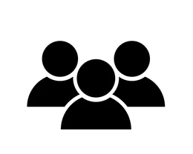
01
Background
This project’s goal is to provide a software for sharing important patient information with their network of loved ones. The goal is to improve communication and transparency in healthcare, offering essential support in challenging situations.
Notes:
The goal of this project is to make a software design that shares important patient information to the network of loved ones catering to that individual. We want to improve communication and transparency between the hospital and the family offering critical support during challenging times.

Slide 5
Vision
Our vision is seeing families less stressed about receiving critical patient information ensuring they are well-informed about ongoing developments, and fostering a sense of assurance and confidence in the information they receive.

Slide 6
Target Audience
The audience that our software is targeted to are families who have a loved one in the hospital. These people are seeking a way to transparently receive patient information so they can stay alert on the status of their loved one.
Notes:
The target audience are to families who have someone in the hospital because these are the people that want better communication about patient information and what to do with that information.

Slide 7
02
Sprint Diagram

Slide 8
Sprint 1: Login and Sign up
Sprint 2: Create Patient profiles and information
Sprint 3: Integration with Backend
Sprint 4: Figma implementation
Sprint 5: Chat with Doctor and Vitals Tabs & Hosting
(WIP)
Project Progress

Slide 9
03
UX/UI

Slide 10
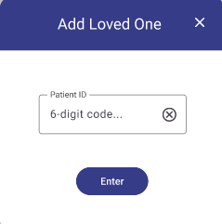
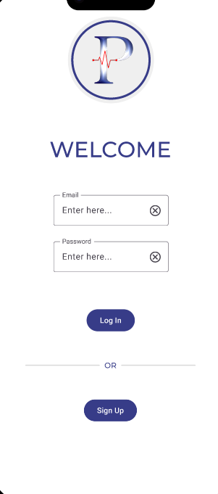
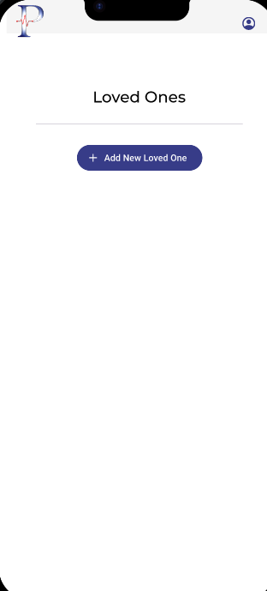
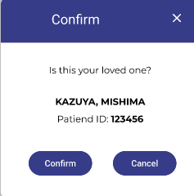
Wire Frame for User (Figma UX/UI)
Login
Adding a “loved one”
Adding a patient

Slide 11
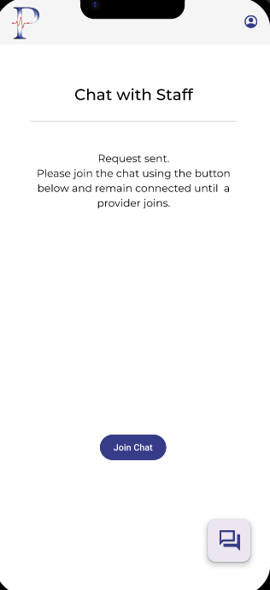
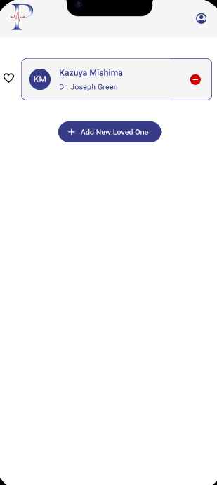
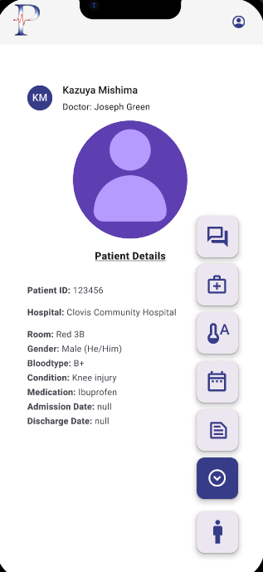
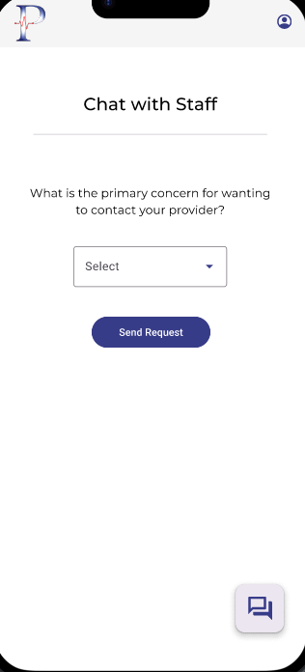
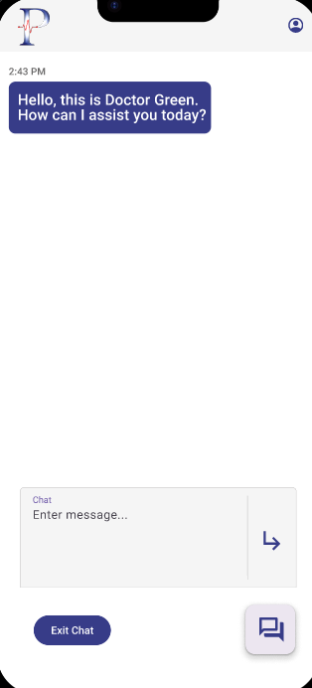
Wire Frame for User Cont.

Slide 12
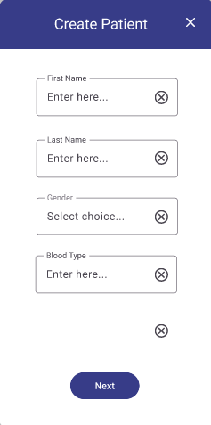
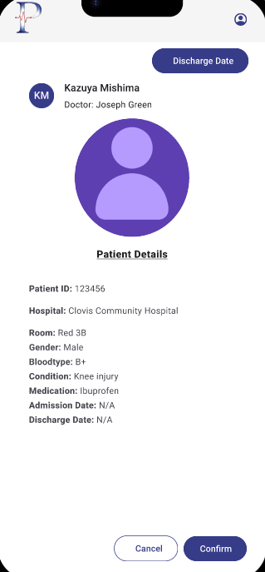
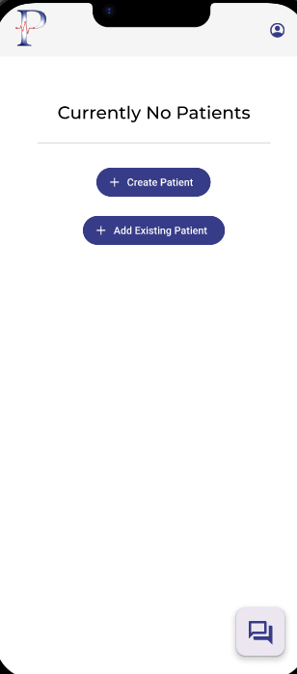
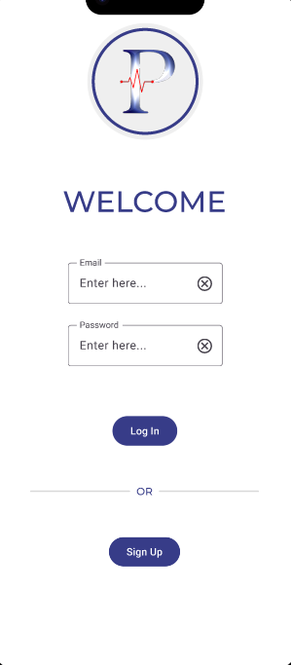
Wire Frame Staff (UX/UI)

Slide 13




Tech Stack
Flutter (Frontend)
Node.js (Backend)
MongoDB Atlas (Database)
Azure Web Hosting

Slide 14
04
Live Demo

Slide 15
05
Q/A Insights

Slide 16
06
Future Plans

Slide 17
Incomplete Work/Future Plans
Chatting Feature – users can contact the staff treating their loved ones.
Calendar – keep track of appointments and important dates.
Push Notifications – quickly track any changes to loved ones medical info.
Dynamic Vitals Information - displays current vitals of loved one.

Slide 18
